Slide 1
Edge detection
Edge detection is an image-processing technique, which is used to identify the boundaries (edges) of objects, or regions within an image.
Edges are among the most important features associated with images.
We come to know of the underlying structure of an image through its edges. Computer vision processing pipelines therefore extensively use edge detection in applications.
Edges are characterized by sudden changes in pixel intensity. To detect edges, we need to go looking for such changes in the neighboring pixels.

Slide 2
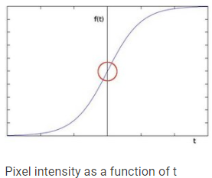
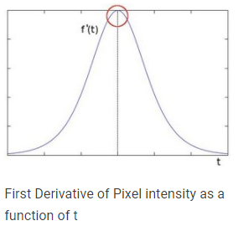
SOBEL EDGE DETECTION
Sobel Edge Detection is one of the most widely used algorithms for edge detection. The Sobel Operator detects edges that are marked by sudden changes in pixel intensity.
The rise in intensity is even more evident, when we plot the first derivative of the intensity function.

Slide 3
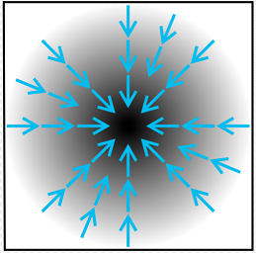
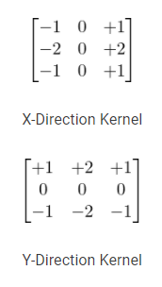
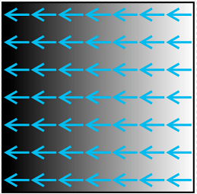
SOBEL EDGE DETECTION
The plot demonstrates that edges can be detected in areas where the gradient is higher than a particular threshold value.
In addition, a sudden change in the derivative will reveal a change in the pixel intensity as well.
With this in mind, we can approximate the derivative, using a 3×3 kernel.
We use one kernel to detect sudden changes in pixel intensity in the X direction, and another in the Y direction.

Slide 4
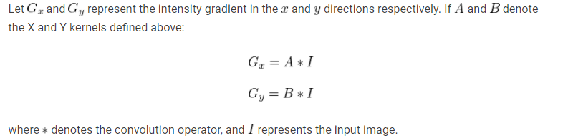
SOBEL EDGE DETECTION
When these kernels are convolved with the original image, you get a ‘Sobel edge image’.
If we use only the Vertical Kernel, the convolution yields a Sobel image, with edges enhanced in the X-direction
Using the Horizontal Kernel yields a Sobel image, with edges enhanced in the Y-direction.

Slide 5
SOBEL EDGE DETECTION
Sobel(src, ddepth, dx, dy)
The parameter ddepth specifies the precision of the output image, while dx and dy specify the order of the derivative in each direction.
For example: If dx=1 and dy=0, we compute the 1st derivative Sobel image in the x-direction.
If both dx=1 and dy=1, we compute the 1st derivative Sobel image in both directions

Slide 6
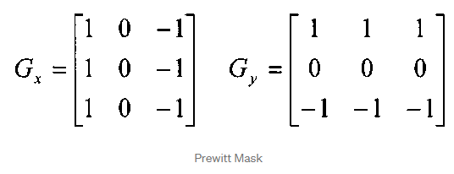
Prewitt EDGE DETECTION
Prewitt’s Edge Detection
Prewitt operator is similar to the Sobel operator and is used for detecting vertical and horizontal edges in images.
However, unlike the Sobel, this operator does not place any emphasis on the pixels that are closer to the center of the mask.

Slide 7
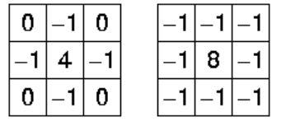
LAPLACIAN EDGE DETECTION
Unlike the Sobel and Prewitt’s edge detectors, the Laplacian edge detector uses only one kernel.
It calculates second order derivatives in a single pass. Two commonly used small kernels are:
Because these masks are approximating a second derivative measurement on the image, they are very sensitive to noise.
To correct this, the image is often Gaussian smoothed before applying the Laplacian filter.

Slide 8
CANNY EDGE DETECTION
Canny Edge Detection is one of the most popular edge-detection methods in use today because it is so robust and flexible.
The algorithm itself follows a three-stage process for extracting edges from an image.
Add to it image blurring, a necessary preprocessing step to reduce noise.
The 4 stages are:
Noise Reduction
Calculating Intensity Gradient of the Image
Suppression of False Edges
Hysteresis Thresholding

Slide 9
CANNY EDGE DETECTION
1. Noise Reduction
Raw image pixels can often lead to noisy edges, so it is important to reduce noise before computing edges.
In Canny Edge Detection, a Gaussian blur filter is used to essentially remove or minimize unnecessary detail that could lead to undesirable edges.
2. Calculating Intensity Gradient of the Image
Once the image has been smoothed (blurred), it is filtered with a Sobel kernel, both horizontally and vertically.
The results from these filtering operations are then used to calculate both the intensity gradient magnitude (G), and the direction (\Theta) for each pixel.

Slide 10
CANNY EDGE DETECTION
3. Suppression of False Edges
After reducing noise and calculating the intensity gradient, the algorithm in this step uses a technique called non-maximum suppression of edges to filter out unwanted pixels (which may not actually constitute an edge).
To accomplish this, each pixel is compared to its neighboring pixels, in the positive and negative gradient direction.
If the gradient magnitude of the current pixel is greater than its neighbouring pixels, it is left unchanged. Otherwise, the magnitude of the current pixel is set to zero.

Slide 11
CANNY EDGE DETECTION
4. Hysteresis Thresholding
In this final step of Canny Edge Detection, the gradient magnitudes are compared with two threshold values, one smaller than the other.
If the gradient magnitude value is higher than the larger threshold value, those pixels are associated with strong edges, and are included in the final edge map.
If the gradient magnitude values are lower than the smaller threshold value, the pixels are suppressed, and excluded from the final edge map.
All the other pixels, whose gradient magnitudes fall in between these two thresholds, are marked as ‘weak’ edges (i.e. they become candidates for being included in the final edge map).
If the ‘weak’ pixels are connected to those associated with strong edges, then they too are included in the final edge map.
Canny(image, threshold1, threshold2)

Slide 12
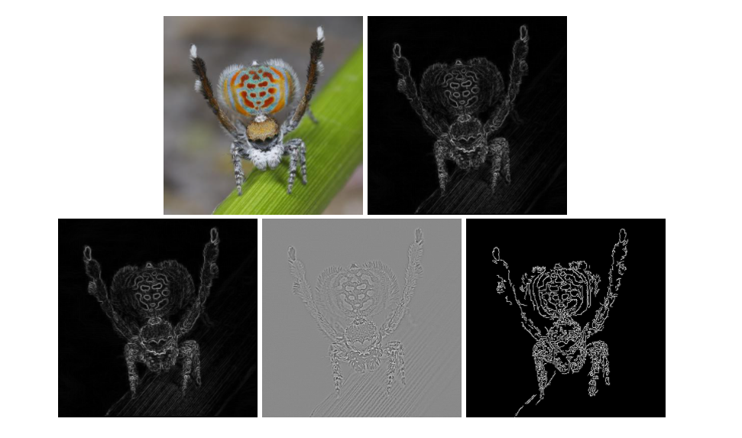
OUTPUT COMPARISON
Order of Images
Original Image
Sobel
Prewitt
Laplacian
Canny Edge

